Slide 1
Finalsite AI Chatbot
Chat with your school: Impact of integrating a Knowledge-based Conversations chatbot

Slide 2
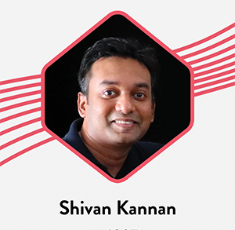
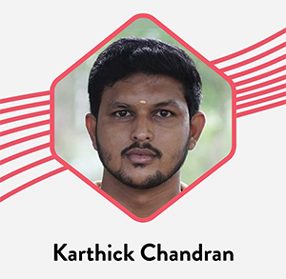
Team members

Slide 3
Project Overview
The main objective of our hack was to integrate a chatbot to the parent’s app. This chatbot will provide the answers related to the website using - OpenAI Embeddings API, - Pinecone Vector Database and - large language model (LLM ChatGPT) framework.
The team completed the following tasks,
Added a chatbot to the parent’s website
Integrated the backend to the chatbot

Slide 4
Technologies Used
OpenAI Embedding API: An API that provides embeddings for text inputs using ChatGPT LLM.
Pinecone: A vector database that helps us store and query embeddings.
Langchain A JavaScript (supports also Python) framework to provide provider-agnostic API (like Terraform for IaC).
Language - Javascript, Typescript

Slide 5
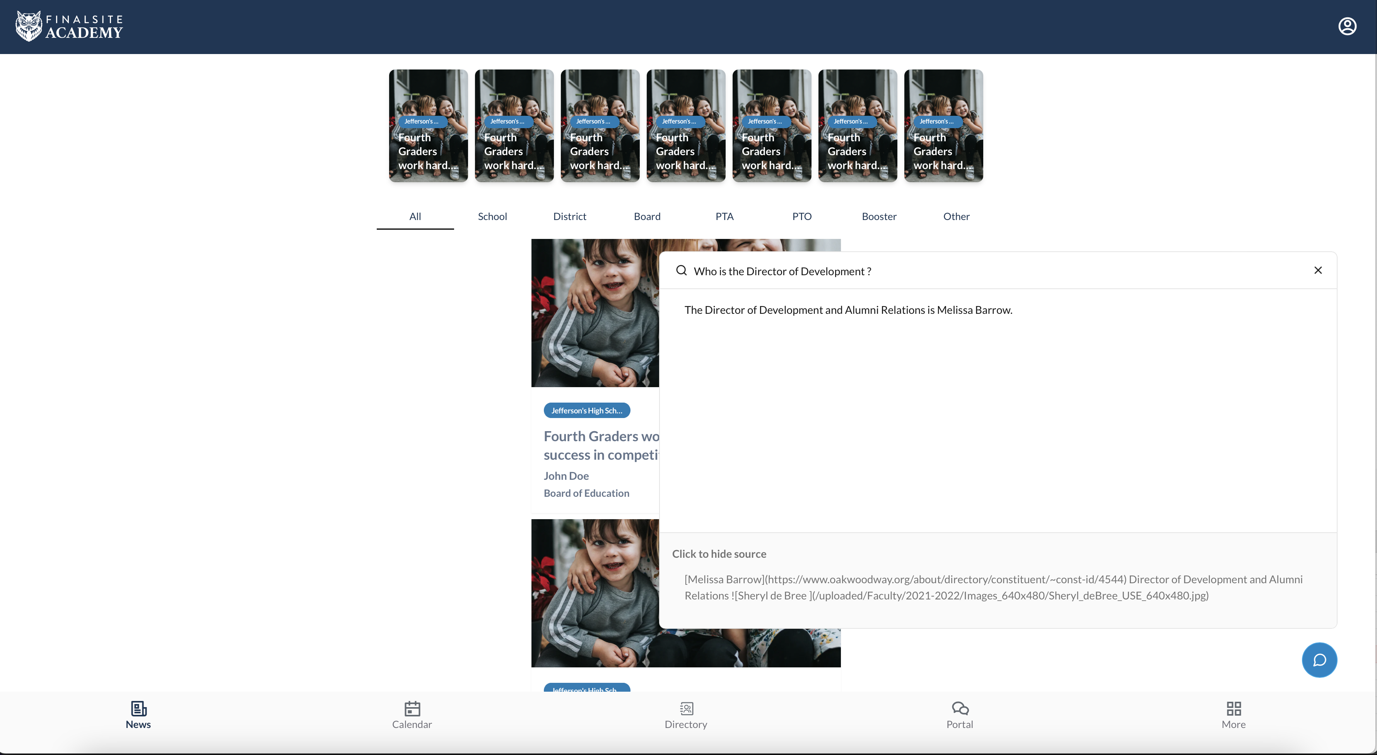
Block diagram
Parent persona
School website

Slide 6
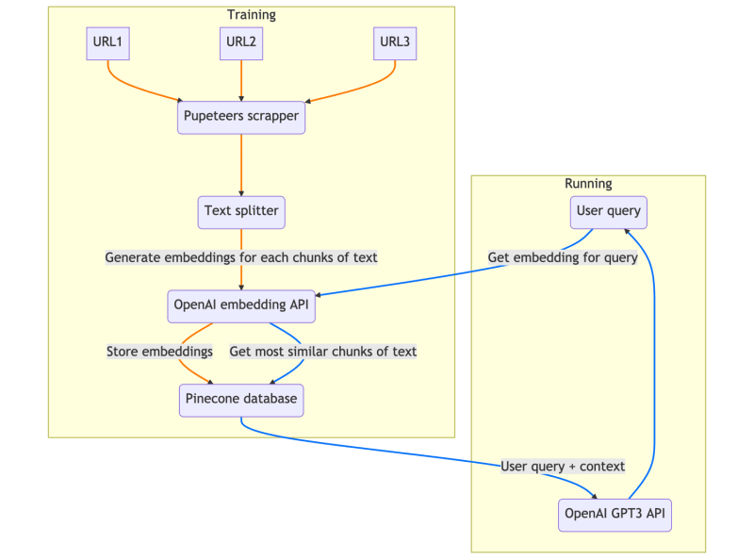
Architecture
Web scraper: to extract content from given URLs
Text splitter: to split the acquired text into chunks for processing
Embeddings generator: to create embeddings from the text chunks using OpenAI's Embedding API
Pinecone vector store: to store and retrieve embeddings efficiently
Langchain LLM: to provide question-answering capabilities based on the embeddings

Slide 7
demo

Slide 8
Future Improvements
Prevent data regeneration for whole website - Now, $0.1 per data generation per school website - We will research how to not regenerate whole data when small piece is update (for operational and cost efficiency)
Reduce cost for chat prompt - Now, 1000 requests roughly $1

Slide 9
Business values
Competitive advantage
Parents satisfaction and engagement
Improved sales and marketing
Personalization of answers

Slide 10
Questions?

Slide 11
Thank you

